Slide 1
+ online

Slide 2
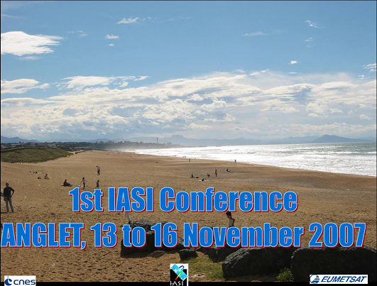
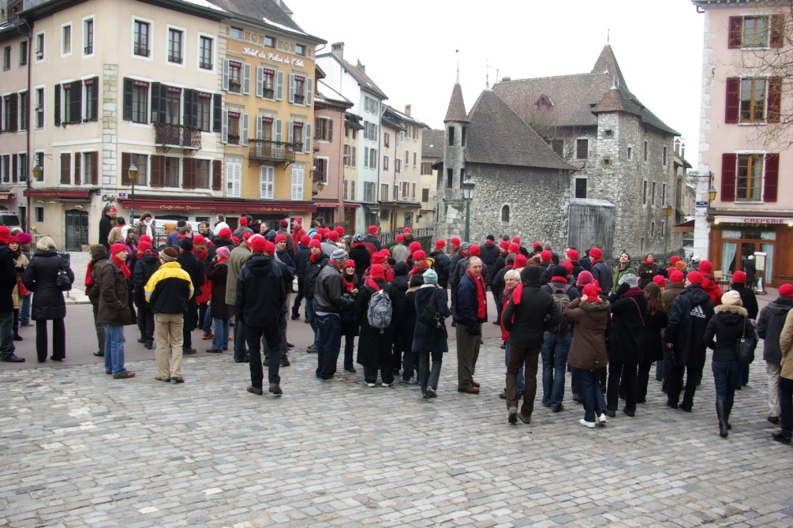
A (very) brief history of the IASI Conferences
November 2007, Anglet
1 year after mission launch
Instrument performance, scientific perspectives
January 2010, Annecy
Consolidated results
Significant impact in NWP
February 2013, Hyères
Atmospheric Composition rising
IASI/Metop-B, first instrument perfo results
April 2016, Antibes - IASI is turning 10
Atmospheric Composition
Climate perspective
2 IASI in Space

Slide 3
A (very) brief history of the 5th IASI Conference
20-24 April 2020 - Evian
14 years and 3 IASIs in space
1
3-7 May 2021 - Evian
14.5 years and 3 IASIs in space
6-10 Dec 2021 - Evian
15 years and 2 IASIs in space
+ online
Still 95 onsite
till 26/11/2021
Oh my crown - variant

Slide 4
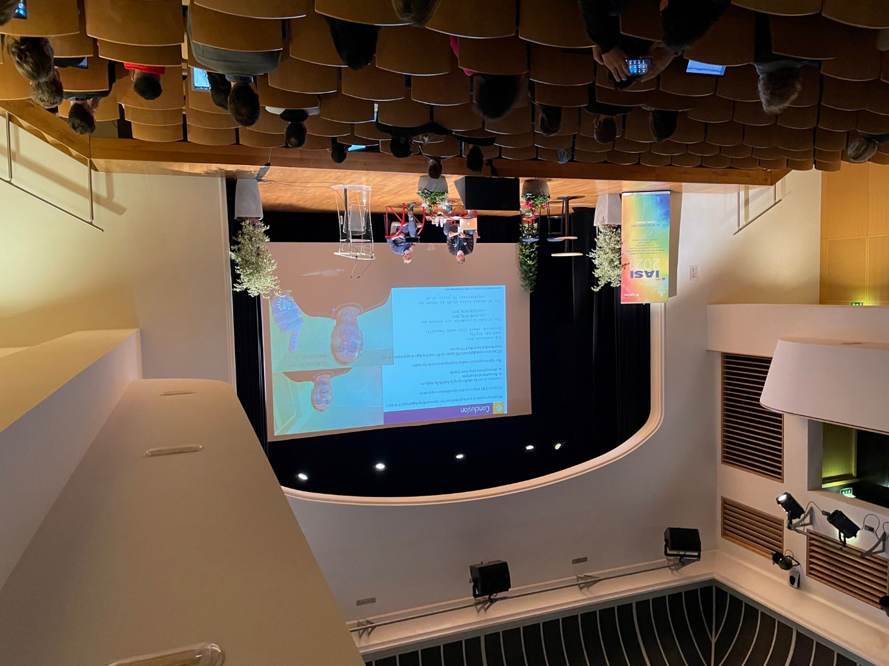
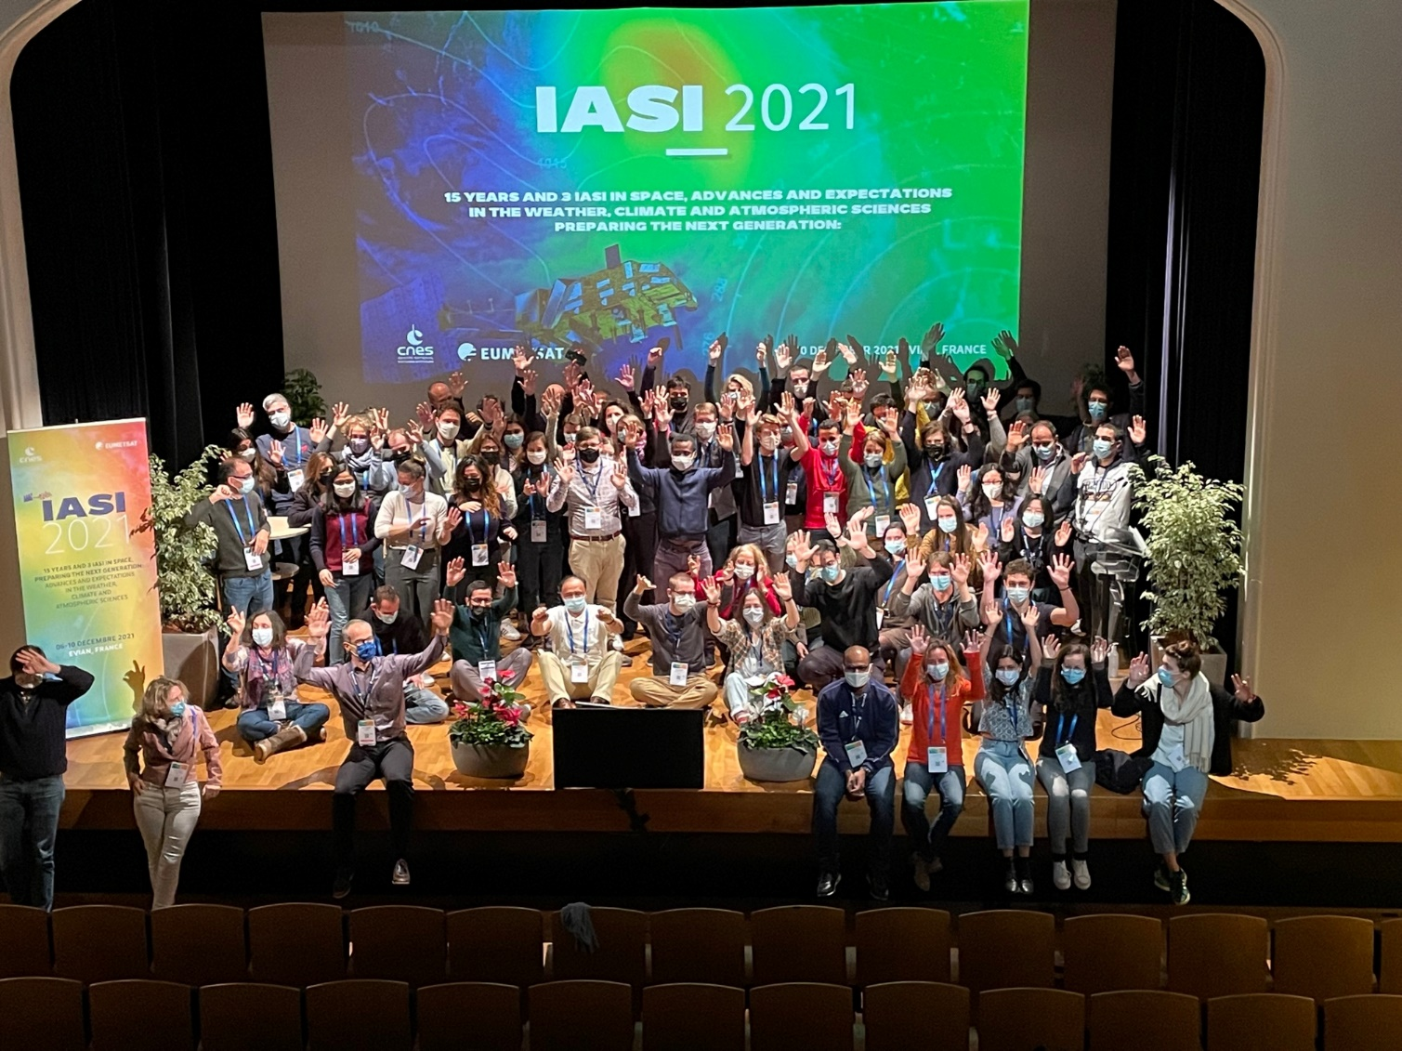

Slide 5
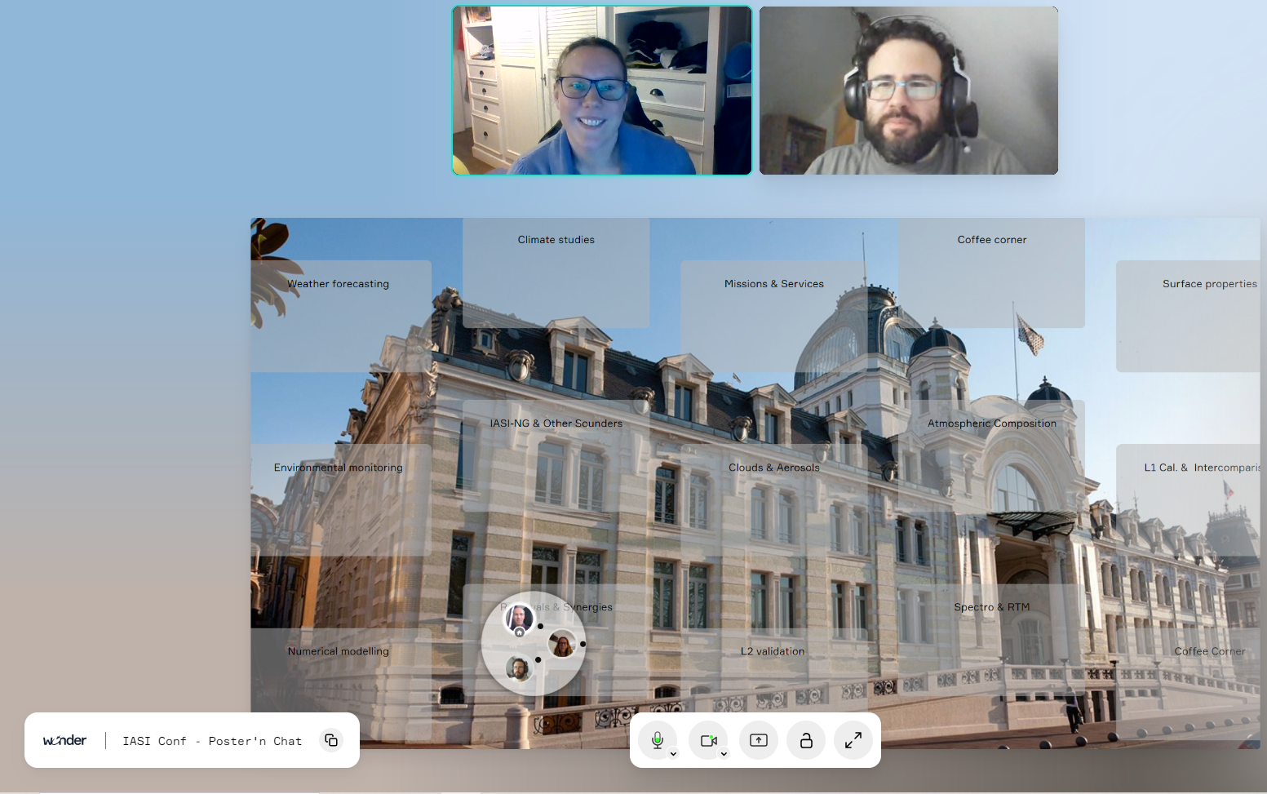

Slide 6
Agility
Patience
Enthusiasm
Great science and exchanges!!!

Slide 7
Poster awards
Marie Doutriaux A fantastic recording for climate data records!
Hélène de Longueville Use and impact of PCA rec’d radiances for atmospheric composition applications.
Marie-Thérèse El Kattar Ground-based high spectral resolution infrared measurements: Application to satellite validation
Elisa Baldit IASI-NG instrument performance verifications

Slide 8
Heard around coffee and posters
« woaw, these instruments experts and presentations are great! I litterally saw a Fourier Transform in action for the first time !»
« It was so good to meet and have time in real, and put scientific projects with other groups in motion again »
« Our research unit suffered from the Covid. This conference clearly also helped our group dynamics! »
« I scored 375 650 points! »
« Was there snow in Sevrier ? »
« All this (NB: science & breakthrough) has been possible thanks to the excellence and stability of the IASI instrument and observations »
« I need homogeneous IASI L1, PC and L2 climate records! »
« This might be the only conference in my whole PhD! »

Slide 9
A few facts & take-aways
78 participants onsite + 30 participants online
Negative tests
Presenters respectful of time, high communication standards
Innovation still flowering after 15 years! Fantastic scientific material!
A state-of-the art program, 80% renewed compared to 2020’s attempt
Special huge thanks to online speakers: clarity, pre-recordings & attendance
2/3 first-timers at the IASI Conference
Young and talented scientists,
a New Generation ramping up for IASI-New Generation
Exemplary gender balance in IASI community
IASI, a climate key player
AC/AQ numerical modeling with IASI, on the rise
Pushing RTM capabilities
Characterising OBS errors, e.g. for ever higher impact in NWP
PCs are your friend
New species detected and monitored, revisiting emission inventories
…and many more…

Slide 10
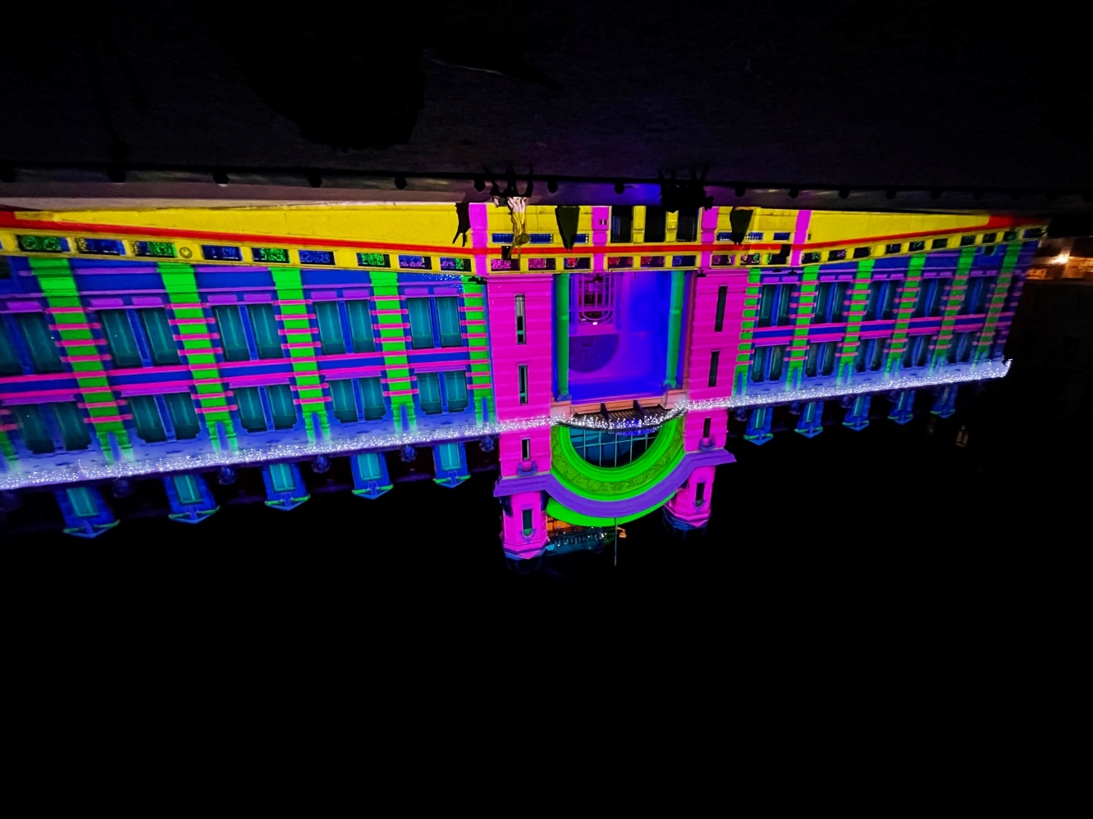
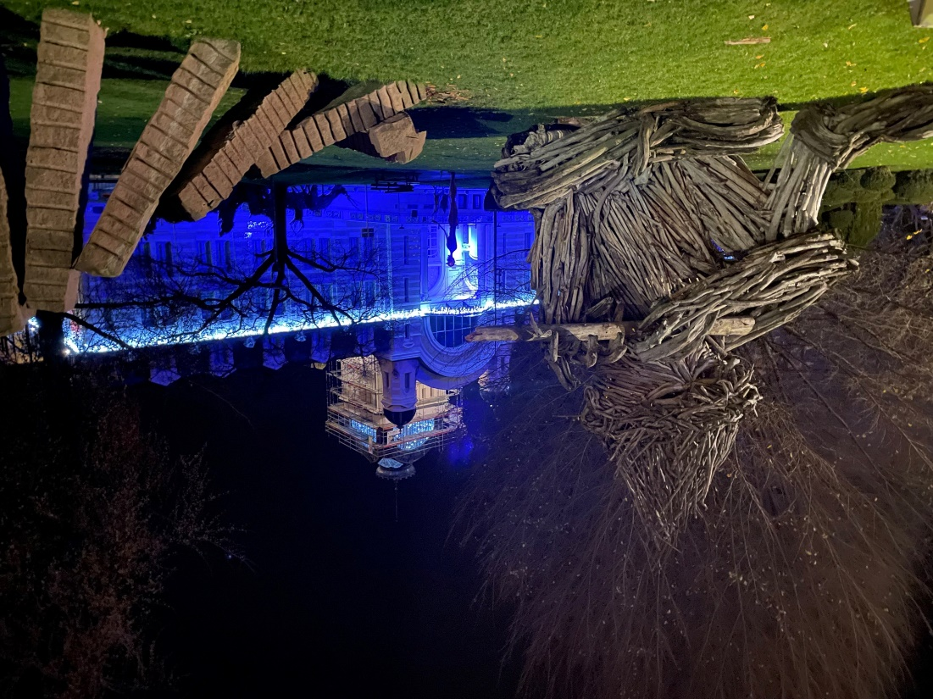
Stay well!
Meet you at the 6th IASI Conference

